Slide 1
Rural entrepreneurs and the new rural economy
Paul Cowie
Global Urban Research Unit
School of Architecture, Planning and Landscape
Newcastle University
Presentation to ReCAP Event
York – 25th January 2013

Slide 2
Context to the research - ‘New Rural Economy’
Outline of the research
The research findings
Implications for rural development

Slide 3
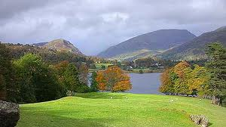
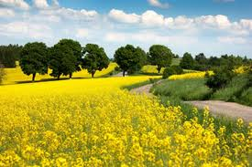
A changing rural economy
Late 20th century decline in traditional rural industry
Globalisation and mechanisation of primary industry
Counterurbanisation a threat and opportunity
‘Gentrification’ of rural areas particularly market towns
Search for a ‘New rural Economy’
Notes:
Since the mid 70’s the rural economy has been in a state of flux. Various forces have been at work to bring about some significant structural changes in rural areas. The mechanisation, comodification of agricultural products and the globalisation of their markets has combined to reduce employment in agriculture and at the same time put downward pressure on rural incomes.
At the same time, particularly in USA and England, there have been structural changes to the social fabric of rural areas. Since the 1970s rural areas have been gaining population at a faster rate than their urban counterparts a phenomena know as counterurbanisation. The gain in rural population has mainly been due to the migration of middle-aged families and those at or approaching retirement. This has more than off-set the out-migration of young adults. These migrants are predominantly middle class and well educated with significant financial resources. Many working age migrants continue to work in the main urban centres and commute to work. These changes have raised concerns over various aspects of rural life, viability of service, house prices and employment for young adults.
These issue have resulted in policy makers seeking ways of rebalancing the rural economy away from primary production. Initially policy focused on farm diversification and tourism. More recently focus has shifted to the potential benefits in-migrants can bring to the rural knowledge economy.

Slide 4
Response to the rural decline
Initially based on farm diversification and tourism development
Has been the idea of a ‘green’ rural economy, agri-environment schemes and ecosystem services
Growing policy interest in the knowledge economy and its impact on rural areas
A focus on the positive aspects of counterurbanisation

Slide 5
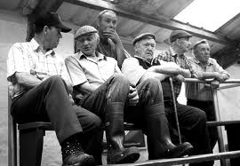
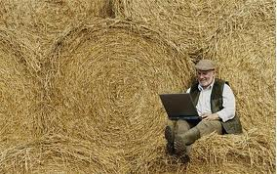
The New Rural Economy
ICT can render the idea of distance redundant
Migration often based on the search for a rural idyll
In-migrant entrepreneurs offer an opportunity to stimulate the rural economy
The knowledge economy depends on the flow of both tacit and codified knowledge
Their extra-local networks offer an opportunity to share new knowledge
Notes:
For many policy makers the knowledge economy offers the perfect solution to the problem of rebalancing the rural economy. ICT offers the opportunity to overcome many of the issues facing rural areas: distance to markets; low wage – low skill jobs and how to retain younger people in the rural workforce.
In-migration is also seen as part of the solution with in-migrants being more likely to start new businesses in the knowledge economy and to seek to grow their businesses once started. They tend to have higher social, financial and human capital than traditional rural residents.
The original research proposal from the CASE Partner, ONE NorthEast, cited Richard Florida’s work on the creative classes and Manuel Castells work on the networked society as ways urban development models could be adapted and translated to rural development. Their hope perhaps was to co-opt in-migrant entrepreneurs to boost the rural knowledge economy. One these innovative entrepreneurs had established themselves in rural communities and economies there would be spill-over affects which would help establish clusters of KIB’s. Further more the in-migrant entrepreneurs would be able to act an key network nodes in linking their extra-local networks with the local networks in aid of development. This linking of networks was thought to happen as a natural part of rural community life. The main issue was therefore could anything be done to help the process and would it be beneficial to have more in-migrant entrepreneurs.
The purpose if this research was therefore to investigate how far in-migrant entrepreneurs could at as a catalyst for change in the rural economy. In particular how far their networks could bridge the local economy and the wider regional and national economy and lead to agglomeration and spill over affects.

Slide 6
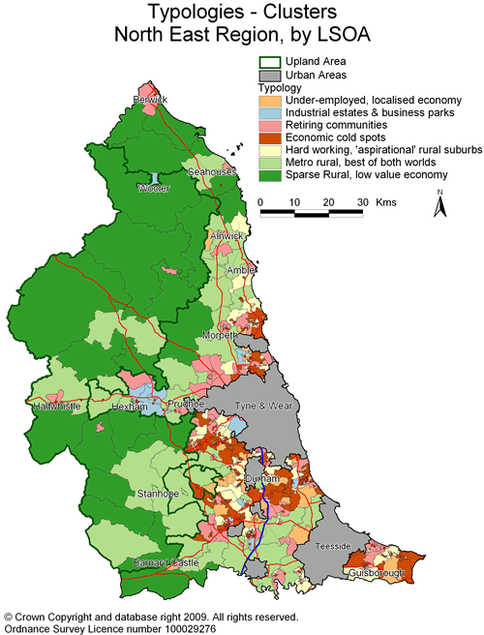
Outline of the research
Research focused on two rural areas in NE England
3 market towns Rothbury, Bellingham and Barnard Castle
Biographical interviews with 30 migrant entrepreneurs
Focus on 3 aspects of the knowledge economy
  Creative and digital
  Business Services
  Other KIBs
Participant Observation in rural enterprise networks

Slide 7
The research findings
In-migrant entrepreneurs differentiate between personal social networks and business social networks
They carefully manage their social networks in particular the overlap
Overlap differs between sectors
  1 = Other KBIs;
  2 = Business Services
  3 = Creative & Digital Industry
1
Personal Social network
Business social network
2
Personal Social network
Business social network
3
Personal Social network
Business social network
Notes:
One of the main research findings was they way in which the entrepreneurs managed their networks. Much of the literature considering rural communities had assumed a dense network of overlapping relationships which encompassed both social and business networks. This conforms to ideas of embeddedness as outlined by academics such as Granovetter and Polyani for example. It is also implied in ideas of social capital such as those outlined by Putnam which has been criticised for having an undifferentiated view of social networks and social capital.
What was clear for the analyses of the interviews and was then observed through the participant observation was that in-migrant entrepreneurs had a clear separation between their personal social networks, those around family, friends and community activity and those that related to their business. A number of entrepreneurs took steps to avoid the two networks overlapping. One entrepreneur who took on a trustee role in a local community development trust made a conscious decision to only look for customers for her business outside the local area. Another entrepreneur, in this case a return migrant, started his business as a community interest company. This got over the problem, as expressed by a number of in-migrant entrepreneurs, of being perceived as using social connections or social institutions to further their business interests.
Recently this differentiation between personal and businesses social networks has been observed in farm based businesses. It has always been a conundrum as to why farmers do not share more equipment. Much farm machinery is very expensive and only used at certain times of the year. The research found the reason for not sharing was routed in a fear of falling out with a neighbour. If an expensive piece of shared machinery was broken at a critical time of the year the risk for this leading to a rift in the social relationship between the farms was considered too high. In place of social relationships the process of sharing farm equipment has often been formalised with sons of farmers setting up contract hire businesses. Thus any dispute can be limited to an economic one.

Slide 8
The research finding
Of the two networks personal social networks took priority
Entrepreneurs managed the overlap to avoid conflict between the two networks
  Extra local business
  Pro bona or at cost for locals
  Community Interest Company
There was a further distinction between ‘classical entrepreneur’ and ‘social entrepreneur’
Notes:
There was of course a degree of overlap between these networks, such an overlap is inevitable in a small community. However were there was overlap, the entrepreneur took steps to privilege their personal social networks even if this was to the detriment of their business. Examples of this were entrepreneurs doing ‘work at cost’ for locals or doing bro bona work to ‘maintain standing in the community’..
The degree of separation was not universal. Certain business such as the more intensive knowledge intensive sectors tended to have the least overlap. This may be a function of the type of business which often relied on national or even international markets.
The business service sector had a slightly higher degree of overlap. However this was often managed through long established formal networking institutions such as Round Table, Rotary Club or Lions. Within these institutions the networking was carried out in conformity to the norms and un written rules of the institution. These institutions are primarily seen as being charitable and communitarian in nature however are recognised as being part of the business establishment in a local area.
The largest overlap was to be found in the digital and creative sector. Here entrepreneurs had much less of a distinction between their personal social networks and their business social networks. One possible reason why creative entrepreneurs do not make as marked a differentiation between the two networks was due to the primary motivation for the business. In the majority of cases, creative entrepreneurs had a more relaxed attitude to the business. The work was an end in its self rather than a means to an end.
This lead to a further insight into the nature rural entrepreneurs. They could be crudely categorised into two types, classical entrepreneurs and social entrepreneurs.
In later interviews when discussion turned to other entrepreneurs in the local area some entrepreneurs also made similar distinctions between those who were proper business people and those who were just playing at running a business. This was certainly not what the individuals being discussed thought about themselves.

Slide 9

Classical Entrepreneur
Classical follows the dominate entrepreneurial narrative
  Dispassionate approach to business, means to an end
  Actively seek outside support and input
  Happy to relinquish control to grow

Slide 10


Social entrepreneurs followed a more relaxed path
  more focused on the lifestyle
  work and business are an end in themselves
  not particularly focused on growing the business
However still have a professional approach to the business

Slide 11
Does place matter?
There was also a difference in the way some sectors developed:
  For technology businesses place began to matter as the business developed.
  They needed to gain access to skilled workforce and be accessible to markets, this often lead to relocation back to urban core
  For creative businesses place also mattered but as a honey pot to attract customers. The rural location often enhanced the opportunity to gain additional business

Slide 12
Rural resilience and localism
The differentiation between the two social networks suggest a completely holistic approach to (rural) regeneration may not be the most effective.
No obvious signs of spill-over affects in some sectors
Further research needed on social networks and social enterprise.

